Slide 1
CAR PRICE PREDICTION
RYAN, NATALIE, DARRYL, JASPREET

Slide 2
The goal of this project was to develop several predictive models for
used car prices. We used a dataset with features such as model, year, transmission, mileage, fuel type, and engine size, to uncover patterns and relationships influencing the pricing of used cars.
INTRODUCTION
Notes:
Ryan

Slide 3
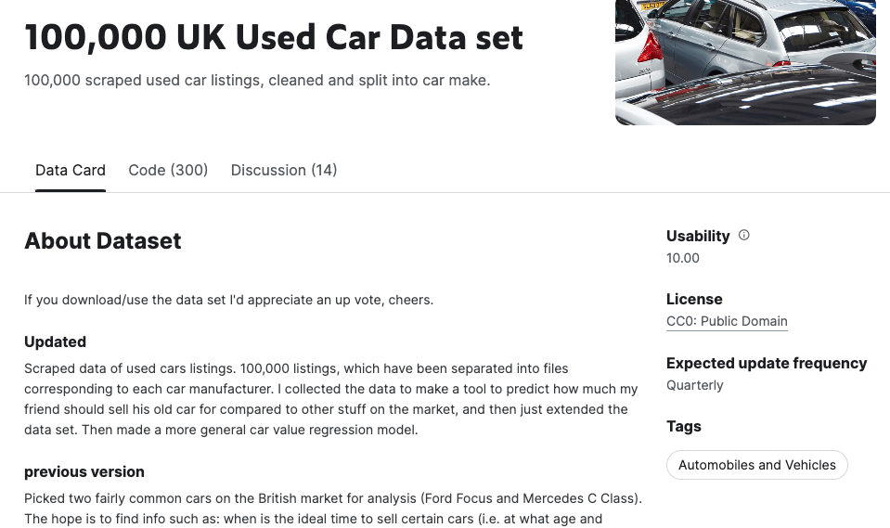
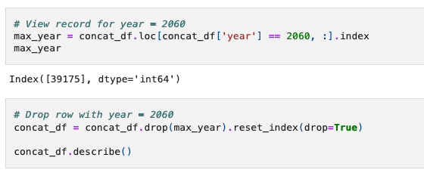
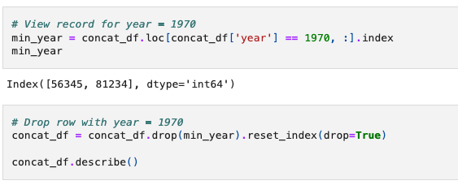
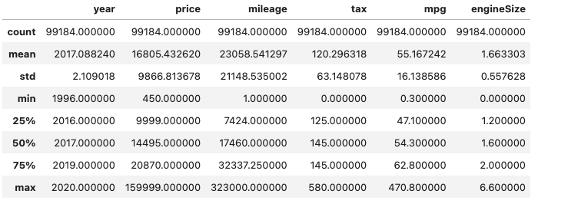
DATA CLEANING
Notes:
Ryan!

Slide 4
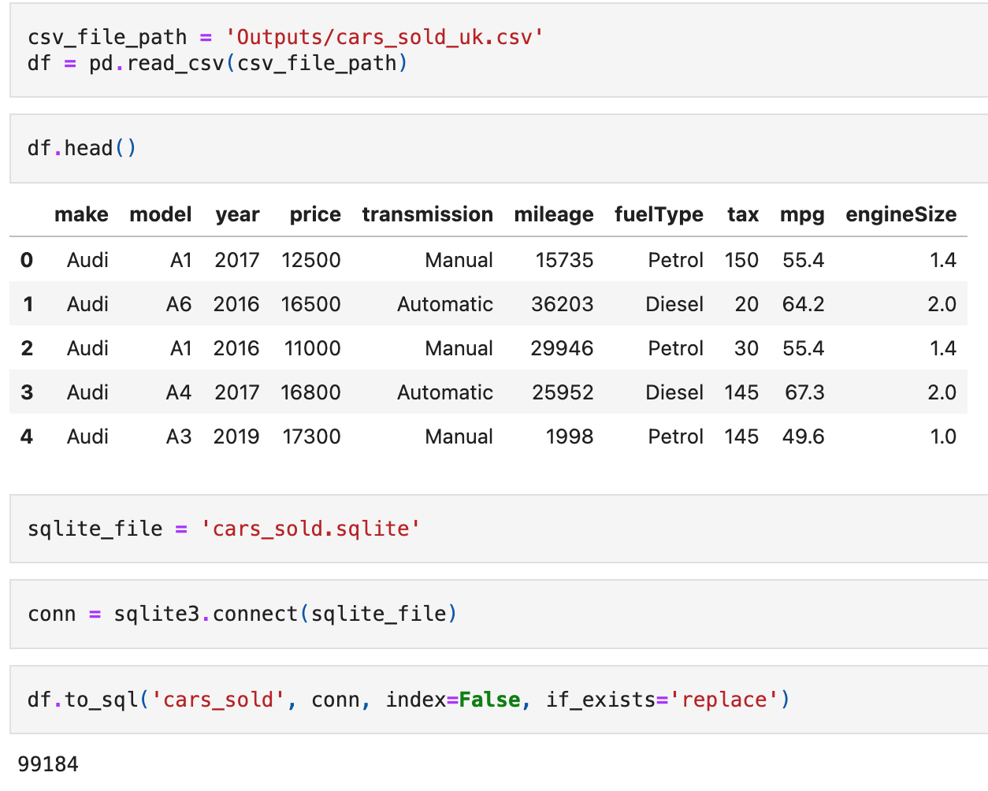
SQL data
The data obtained from Kaggle underwent
cleaning and pre-processing, involving the
removal of NaN values and potential outliers. Subsequently, a connection to an SQLite database was established, empowering the
execution of commands and queries directly within the database.
Notes:
Sql data Darryl

Slide 5
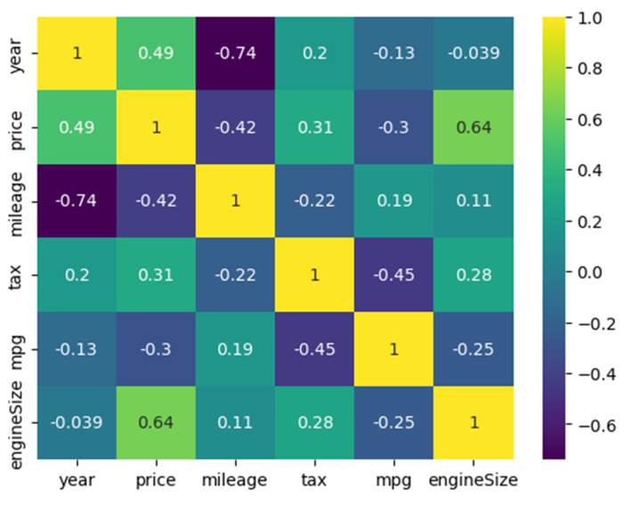
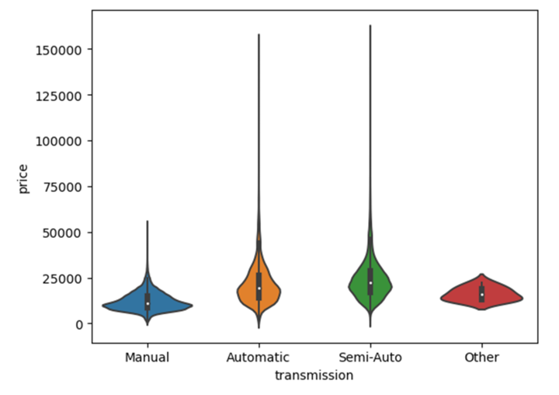
Data visualisations
To get a better idea of the data set we used a correlation matrix. Before building any machine learning
model we looked at which variables are
correlated, to can gain a better
understanding about what’s most
important for our models. Price measure against engine size and year of the car showed a positive relationship. Price measure against mpg and mileage
showed a negative relationship.
To enhance the representation of data
variation, a violin plot was employed. Notably, both automatic and semi-auto transmissions exhibit higher mean prices, accompanied by
instances of extreme prices. The make of the
car is also a critical factor in this analysis.
Notes:
Visualiations – natalie

Slide 6
MODELS USED
01
03
PCA and linear regression
Decision tree regressor
PCA is a technique involved in converting variables which are correlated into
independent variables without changing the variability
This is a supervised machine
learning algorithm that is used by
the Train Using AutoML tool and
classifies or regresses the data using true or false answers to certain
questions
04
02
Random forest model
A Random Forest model is an
ensemble learning technique used for both classification and regression
tasks. It is constructed from multiple
decision trees during training and
outputs the mean (regression) or
mode (classification) prediction of the individual trees for the given input.
RANSAC model
RANSAC, which stands for Random Sample Consensus, is an iterative algorithm
commonly used in robust regression to deal with outliers in a dataset. It is particularly
useful when there are data points that
deviate significantly from the overall
pattern.
Notes:
Natalie babes

Slide 7
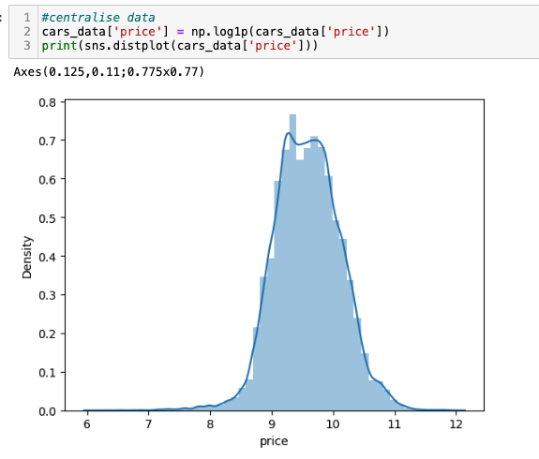
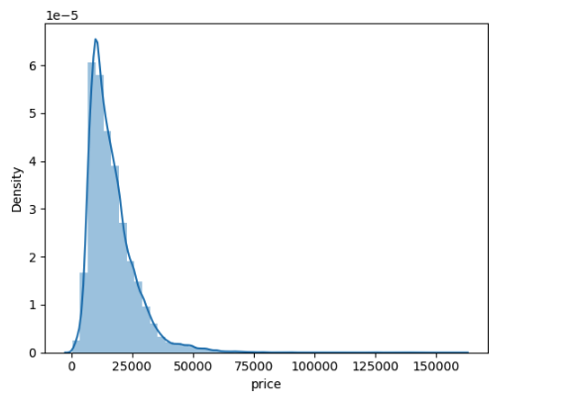
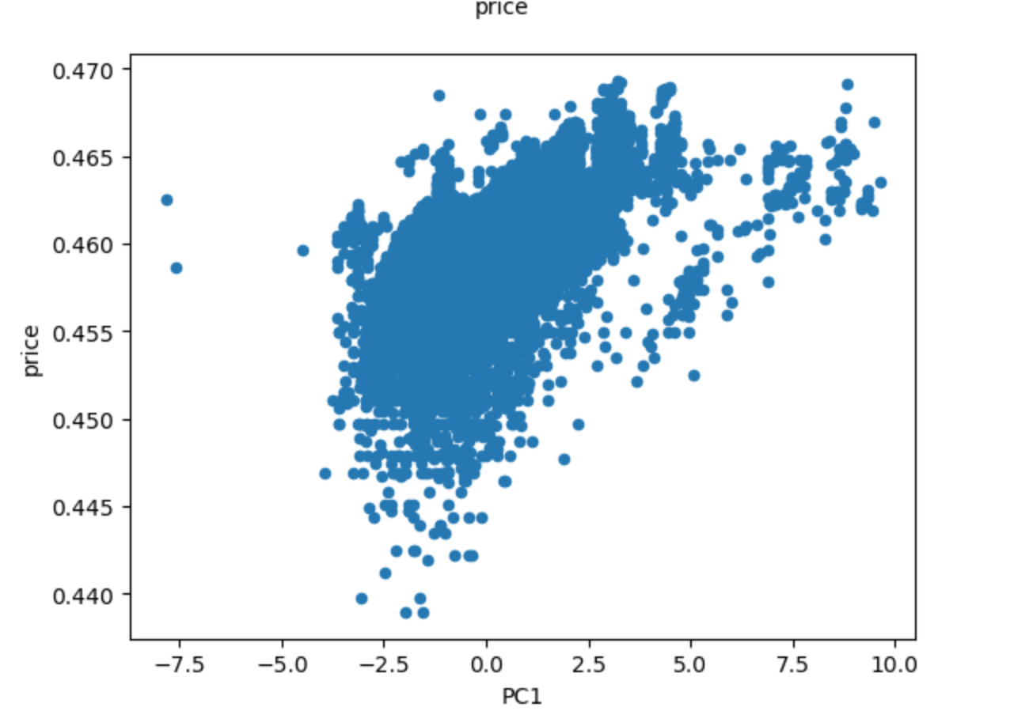
PCA AND LINEAR REGRESSION
When using PCA (Principal Component Analysis) in combination with linear regression, the typical
approach involves reducing the dimensionality of the feature space using PCA and then applying
linear regression on the reduced set of principal components. This can be particularly useful in
scenarios where the original feature space is high-dimensional or when you want to reduce
multicollinearity among features.
Notes:
Me lol

Slide 8
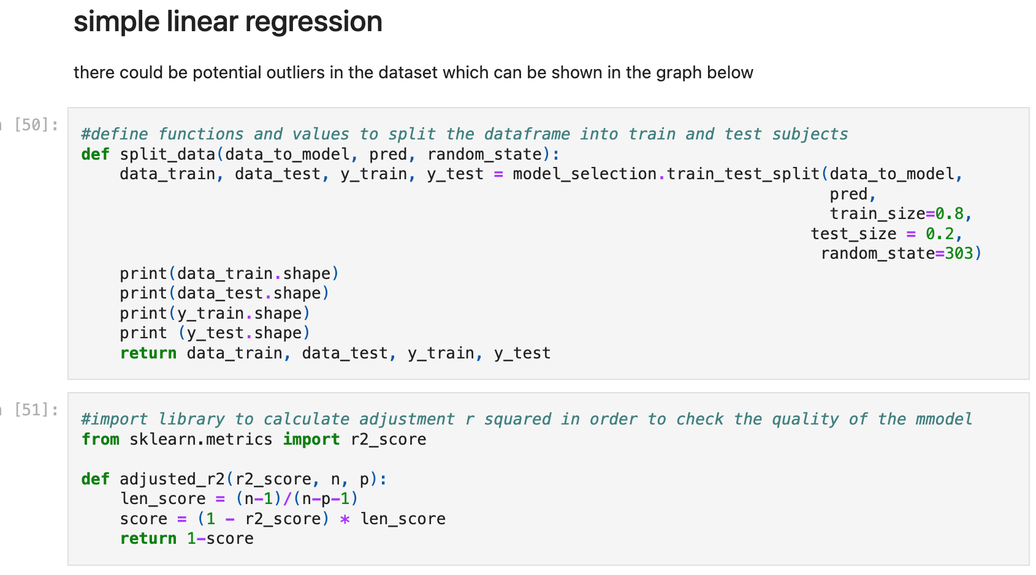
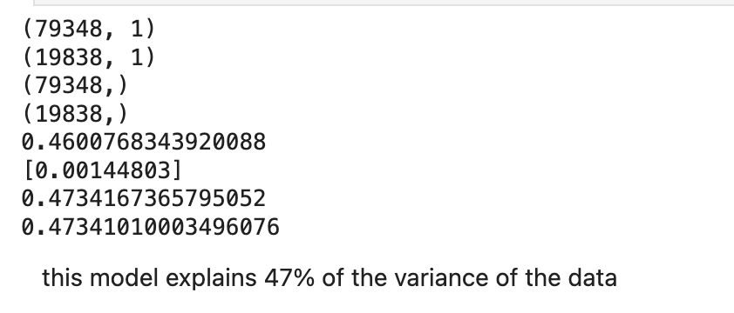
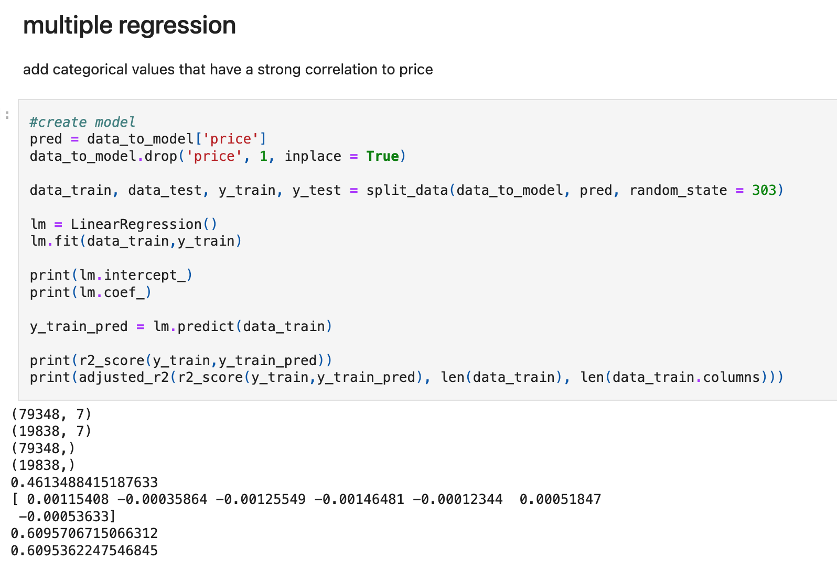
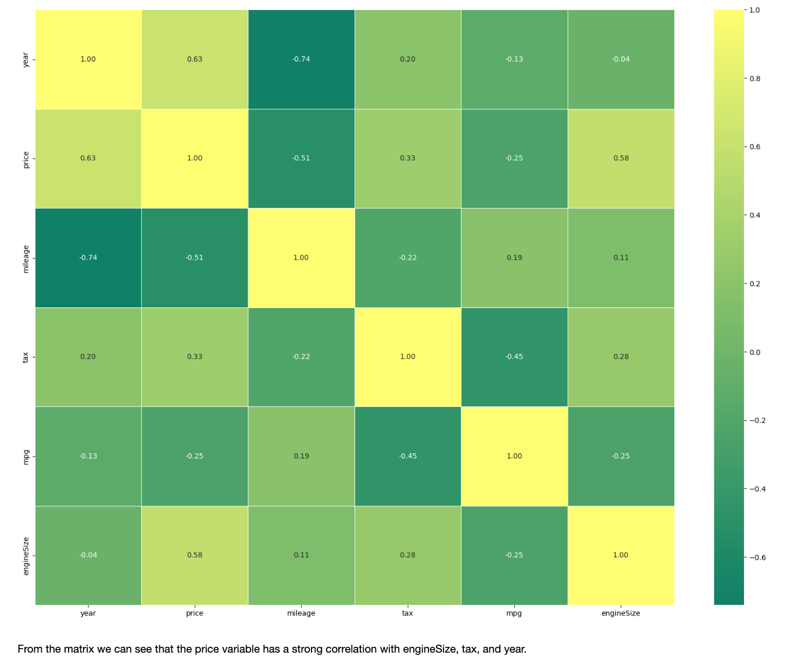
PCA AND LINEAR REGRESSION
Notes:
Me again slay

Slide 9
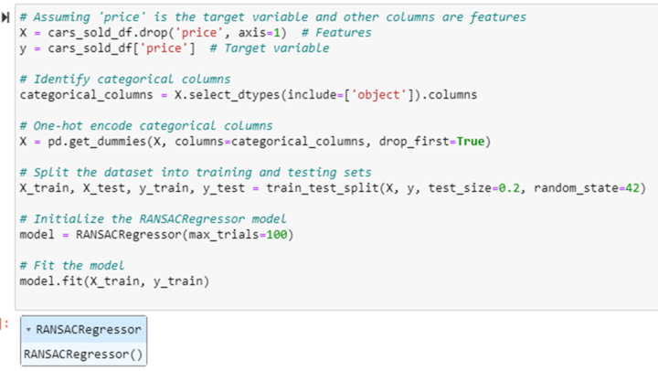
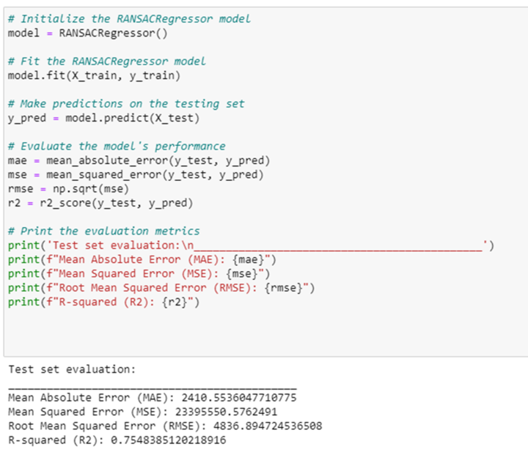
RANSAC MODEL
Predicting Car Prices with RANSACRegressor:
Data Preparation:
Extracted features (X) from 'cars_sold_df,' excluding the 'price’
column.
Set the target variable (y) to the 'price' column.
Handling Categorical Variables:
Identified and one-hot encoded categorical columns in X.
Train-Test Split:
Split the dataset into training (80%) and testing (20%) sets.
Ensured reproducibility with random_state=42.
Model Initialization and Training:
Initialized a RANSACRegressor model with a maximum of 100 trials.
Trained the model on the training data.
Result:
Obtained a trained RANSACRegressor model capable of predicting
car prices, considering potential outliers.
Model Training:
Utilized RANSACRegressor with default settings on the training data.
Prediction and Evaluation:
Made predictions on the testing set.
Evaluated using metrics: MAE, MSE, RMSE, R2.
Results:
Obtained predicted car prices on the testing set along with key evaluation metrics.
Interpretation:
Interpreted metrics (MAE, MSE, RMSE, R2) to gain insights into the model's performance.
Notes:
Ransac – natalie

Slide 10
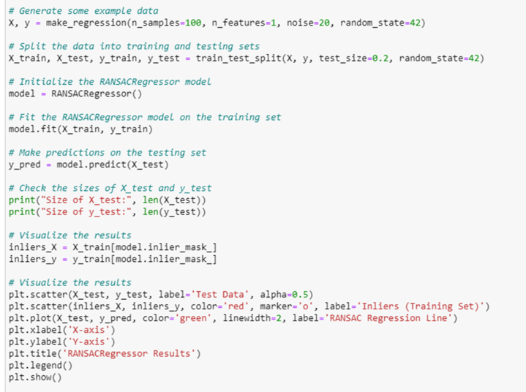
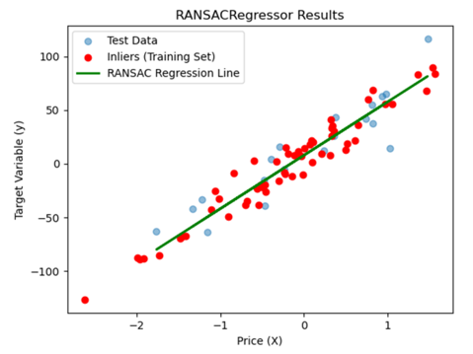
RANSAC MODEL
Prediction and Visualization:
Generated predictions on the testing set.
Visualized results using a scatter plot, emphasizing inliers, and showcasing the RANSAC regression line.
Check Data Sizes
Displayed sizes of the testing set and the corresponding target variable.
Outcome
Effectively demonstrated the model's ability to handle outliers through visualized results, providing insights into its performance on the testing data.

Slide 11
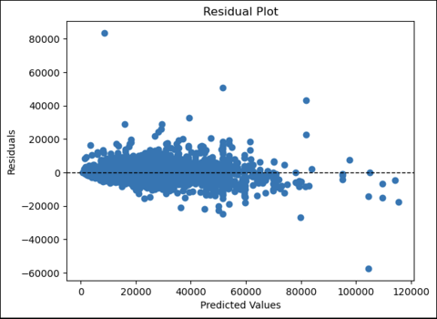
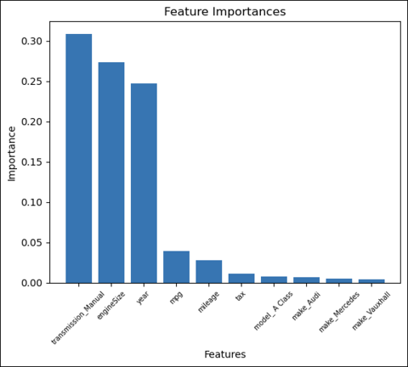
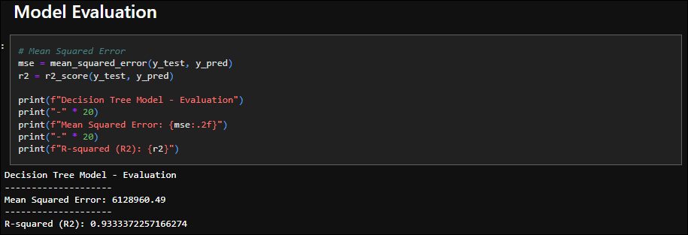
DECISION TREE REGRESSOR
The model excels in capturing
nonlinear relationships, providing interpretable insights into how input features contribute to predictions. The splitting criteria, often Mean Squared Error, guide
decisions at each node, and the model is prone to overfitting,
which can be mitigated through
techniques like pruning.
Notes:
Decision tree regressor - ryan

Slide 12
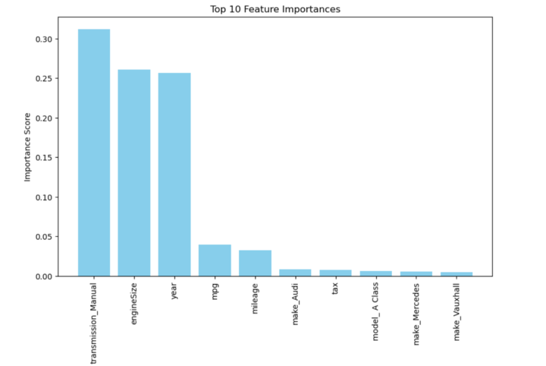
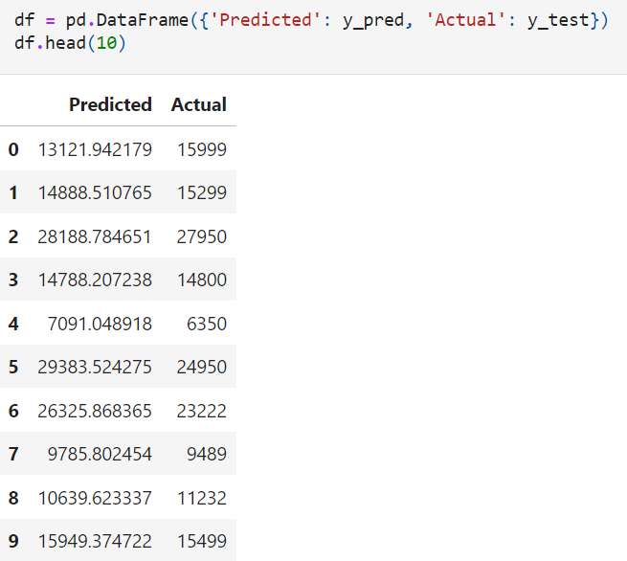
RANDOM FOREST TREE
the final prediction is determined by aggregating the predictions of individual trees. Random Forests excel in handling
high-dimensional data, noisy datasets, and providing robust predictions. They reduce overfitting by introducing randomness and
decorrelating trees. The ensemble approach enhances predictive accuracy, and feature importance analysis can highlight the
contributions of different features.
Notes:
Random forest tree – Darryl

Slide 13
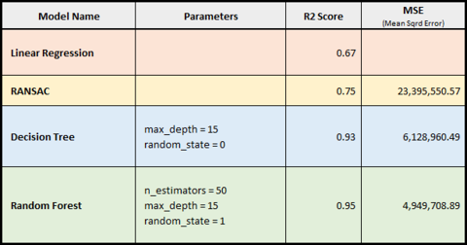
EXCEL BREAKDOWN
Notes:
Excel breakdown

Slide 14
EVALUATION
If we had the opportunity to repeat this project, we would use live API data to build the model on
real-time data
Additionally, we could have used the mean squared error metric across all models to work out
absolute error.
It would also be good to use cross validation techniques to help gauge how well the model works
with unseen data
Notes:
Evaluation me

Slide 15
THANK YOU
Notes:
NO QUESTIONS AT ALL

